Slide 1


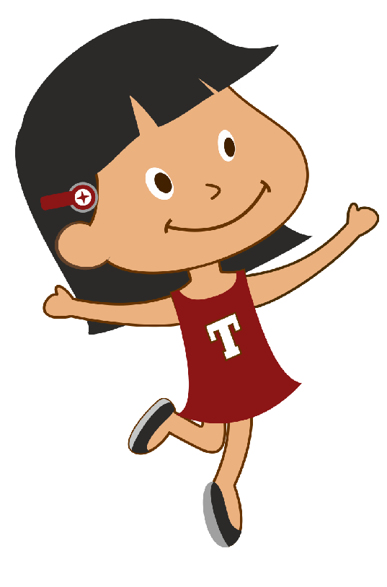
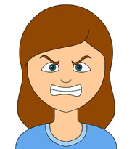
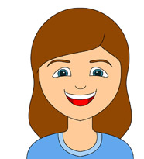
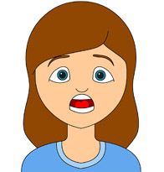
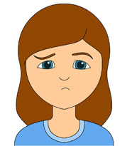

Insert header
Hi, I am Tina.
We go through so many emotions everyday. Sometimes we are sad and some times happy.
Can you help me identify all the different emotions ?
Click on the play button to get started.

Slide 2
Lets take a look at all the different emotions
This is happy
This is sad
This is angry
This is scared
Lets now play the game.
Click on the play button to get started
Happy
Sad
Angry
Scared

Slide 3
Insert header
Hi, I am Tina.
We go through so many emotions everyday. Sometimes we are sad and some times happy.
Can you help me identify all the different emotions ?
Click on the play button to get started.

Slide 4
Select the face that shows being angry.

Slide 5
Select the face that shows being sad.

Slide 6
Select the face that shows being happy.

Slide 7
Select the face that shows being scared.

